Slide 1
Two Primary Topics in this Course
Universal Morality
Arguments that self-interest is primary to human nature.
Arguments that a regard-for-others is primary to human nature.
Global Justice
International Legality
Civil Disobedience
Fairness

Slide 2
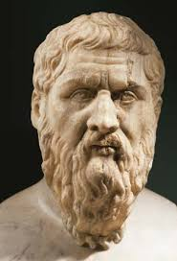
Plato (around 427-347 BC)
Main Themes
Arguments for and against the theory that humans are self-interested by nature.
Readings
The Republic (Story of Gyges’ Ring and Socrates’ response)

Slide 3
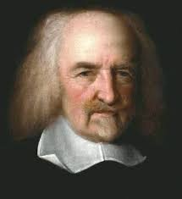
Thomas Hobbes (1588-1679)
Main Themes
Self-preservation
Social Contract
State of Nature
Readings
Leviathan

Slide 4
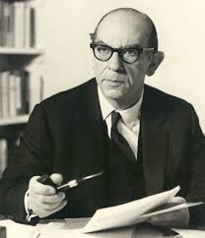
Isaiah Berlin (1909-1997)
Main themes:
Freedom
The history of philosophy
Readings
“Two Concepts of Liberty”

Slide 5
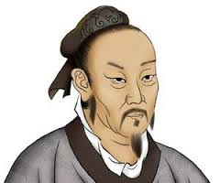
Mencius (孟子) (372-289 BC)
Main Themes
Human Nature as Goodness
Compassion and Sympathy
Readings
The Mencius, chapter 2A

Slide 6
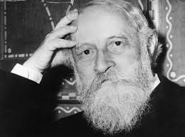
Martin Buber (1878-1965)
Main Themes
Interpersonal Ethics
Readings
I and Thou

Slide 7
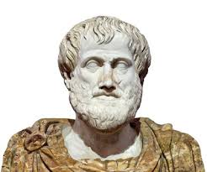
Aristotle (384-322 B.C.)
Main Themes
Virtue Ethics
Habits
the Mean
Readings
The Nicomachean Ethics

Slide 8
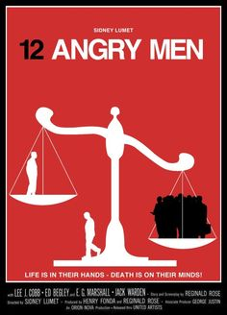
12 Angry Men (1957 film)

Slide 9
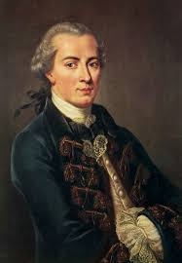
Immanuel Kant (1724-1804)
Main Themes
Universal Morality
The Categorical Imperative
Readings
Groundwork for the Metaphysics of Morals

Slide 10
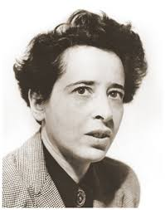
Hannah Arendt (1906-1975)
Main Themes
The Holocaust
Banality of Evil
Global Justice
Civil Disobedience
Readings
Eichmann in Jerusalem

Slide 11
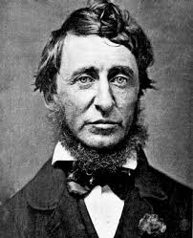
Henry David Thoreau (1817-1862)
Main Themes
Civil Disobedience
Universal Morality
Readings
“On the Duties of Civil Disobedience”

Slide 12
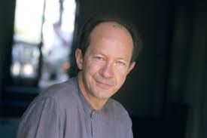
Georgio Agamben (1942- )
Main Themes
Potentiality and Power
Political Resistance
Readings
“On What We Cannot Do”

Slide 13

Citizenfour (2014 Film)
About Edward Snowden

Slide 14
Student Introductions
What is your name?
What year are you in at the University?
What is your major (or academic interests)?
What is your favorite hobby?

